Slide 1
TRAVEL BOOKING SYSTEM

Slide 2
Introduction
A. Problem Definition:
Insight: Clearly articulate the pain points in the current travel booking process. This could involve:
Fragmentation: Users having to visit multiple websites to compare flights, activities.
Information Overload: Difficulty in sifting through vast amounts of options and reviews.
Time Consumption: The lengthy process of searching, comparing, and booking different travel components.
Trust and Security Concerns: Worries about the reliability of less-known booking platforms.
Value: A well-defined problem statement justifies the need for your travel booking system and sets the stage for its purpose.
B. Aim and Objective of the Project:
Insight: The aim should be the overarching goal (e.g., "To develop a user-friendly and comprehensive online travel booking system"). Objectives should be specific, measurable, achievable, relevant, and time-bound (SMART) steps towards achieving this aim (e.g., "To implement a module for searching and booking flights from at least three major airlines
within the first three months)….
Value: Clear aims and objectives provide direction and allow for progress tracking and evaluation of the project's success.
C. Scope and Limitation of the Project:
Insight: Define what features your system will include (scope) and what it will not include (limitations) within the given timeframe and resources. Limitations could be excluding car rentals, travel
insurance, or integration with specific niche providers in the initial phase.
Value: A well-defined scope manages expectations and prevents scope creep, ensuring the project remains focused and achievable. Limitations acknowledge constraints and provide context.
D. Project Management Plan:
Insight: Outline how the project will be managed. This includes:
Team Structure and Roles: Define responsibilities of team members.
Communication Plan: How will the team communicate (meetings, reports, tools)?
Risk Management: Identify potential risks (technical, resource-related) and mitigation strategies
Quality Assurance: How will the quality of the system be ensured?

Slide 3
Background Study and Literature Overview
a. Literature Overview:
Insight: Research existing online travel booking platforms (e.g., Booking.com, Expedia, book my show, red bus,make my trip), academic papers on e-commerce, human- computer interaction in travel, database design for booking systems, and relevant technologies. Understand their features, functionalities, user interfaces, and underlying architectures.
Value: This provides a theoretical foundation and helps you learn from existing solutions, identify best practices, and avoid reinventing the wheel.
b. Critical Appraisal of Other People’s Work:
Insight: Analyze the strengths and weaknesses of the platforms and research you reviewed. What do they do well? Where do they fall short? Are there any usability issues, performance bottlenecks, or missing features that your system could address?
Value: This demonstrates critical thinking and justifies your project by highlighting the gaps or areas for improvement in existing solutions.

Slide 4
Functional Requirements
A. User-side Functional Requirements:
User Registration & Login
Users can register using email, phone number, and password.
Users can securely log in and manage their profiles.
Booking Services
Users can search and book:
Trains
Buses
Flights
Tours (e.g., vacation packages)
Booking History
Users can view all current, past, and canceled booking
Reviews and Feedbacks System
User can send the reviews and feedbacks that the developers fix the bugs and
make
User interface, experience and features at optimal level.
Non-Functional Requirements
Usability
Intuitive, mobile-friendly interface, responsive
Performance
Fast search results; system should handle multiple simultaneous users.
Scalability
Ready to support a growing number of users and bookings API integration is now in Undergoing process.

Slide 5
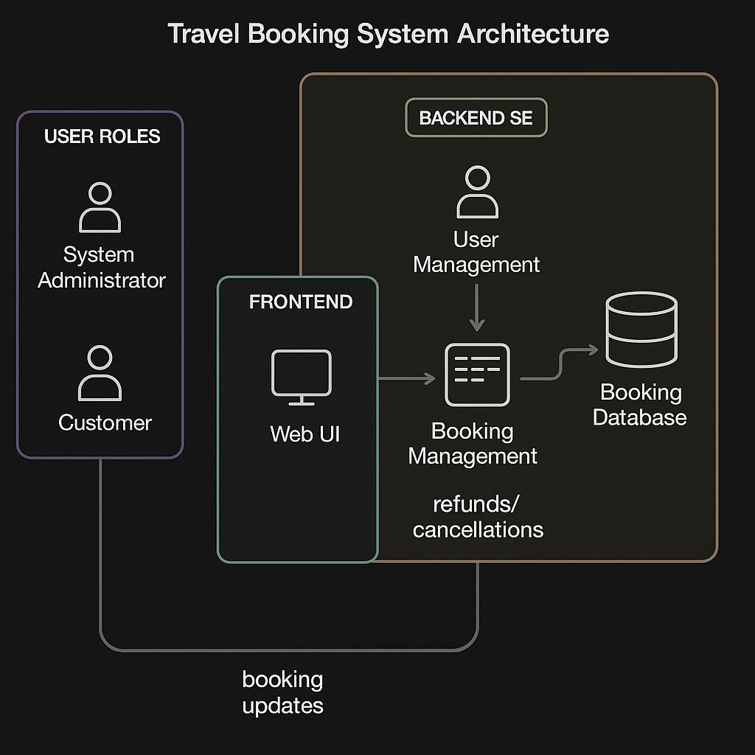

Slide 6
5. Implementation Details
The Travel Booking Website is a PHP-based web application with MySQL as the backend. It is designed to facilitate users in booking tours and travel transportation independently. The system allows user registration, authentication, and interaction with two distinct features: Tour Booking and Travel Booking.
Project Structure (Files & Modules)
All files are organized under the root directory:
travel_booking_project/

Slide 7
Module Features
Home Page highlights:
Handpicked Locations: Tour recommendations pulled from tours table.
Customer Gallery: Displays GIFs and travel images.
Happy Customers: Pulls 5-star reviews from reviews table.
Popular Destinations: Featured tours with direct "Book Now" links.
Tours Module
Tours Page (tours.php):
Lists all available tours.
Clicking "Book Now" redirects to tour_booking.php.
Tour Booking Page:
Tour details shown.
User can confirm booking and submit a review.
Data is stored in tour_bookings and reviews.
Travel Module
Travel Booking Page (travel_booking.php):
User selects mode: Bus, Train, or Plane.
Enters source, destination, and travel date.
Available transport options are fetched from availabletransports.
User selects one and books it.
Booking details are stored in travel_bookings.
Tour and Travel Booking Success:
Displays all booking information upon confirmation.
Common Pages
Login/Registration: Stored in users table.

Slide 8
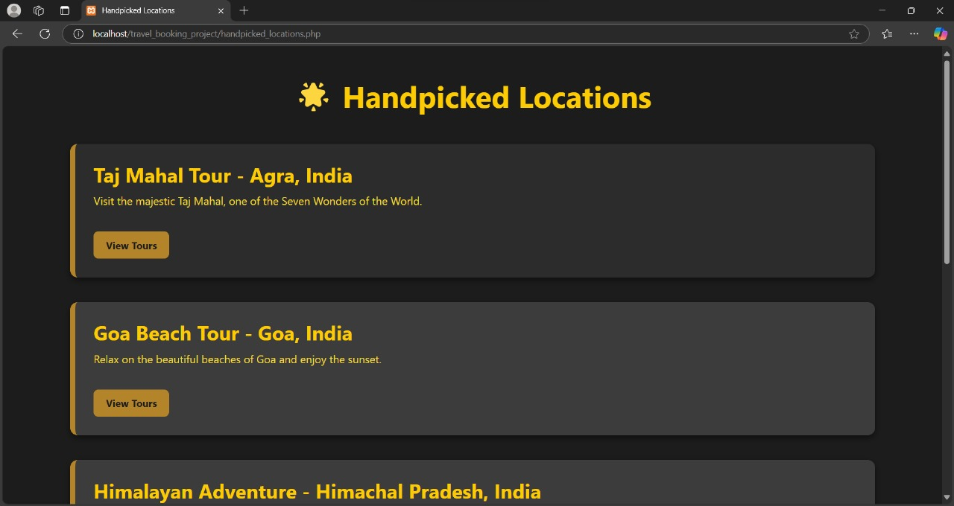

Slide 9
Integration and Testing
Integration Description
Since Tour Booking and Travel Booking are independent modules, integration is minimal:
User Authentication Integration
Users must log in or register (users table) to access bookings.
Shared login session allows access to both modules.
Tour Booking Flow
Navigation: home.php → tours.php → tour_booking.php → tour_booking_success.php
Data Flow:
Tour data: tours table
Booking: tour_bookings
Reviews: reviews
Travel Booking Flow
Navigation: home.php → travel_booking.php → travel_booking_success.php
Data Flow:
Transport options: availabletransports
Booking: travel_bookings

Slide 10
Performance Analysis
Centralized Booking Management:
Integrates various transportation services (e.g., private vehicles, buses) into a single system, minimizing complexity and time for both users and administrators.
User Experience Optimization:
Smooth and responsive user interface enables users to search, book, and manage their travel plans efficiently.
Load Handling Capability:
Backend architecture supports concurrent user access without significant drops in performance, using optimized database queries and server-side scripting.
Data Accuracy & Consistency:
Reduces human error by automating data validation during booking and registration processes.
Security Measures:
Utilizes secure authentication, encrypted payments, and role-based access (Admin, User, Registrerer) to protect user data and system integrity.
System Maintainability:
Modular code structure and clean database schema make the system easier to update, debug, and scale as new features are added.
Analytics & Monitoring:
Capable of tracking usage metrics (number of bookings, peak hours, routes in demand) to help administrators make data-driven decisions.

